Slide 1

SENTIMENT CLASSIFICATION
A sentiment analysis approach based on NLP
MENTOR : DR. SURINDER KAUR

Slide 2

What is NLP?
Natural language processing (NLP) refers to the branch of computer science—and more specifically, the branch of artificial intelligence concerned with giving computers the ability to understand text and spoken words in much the same way human beings can.

Slide 3
USECASES OF PROJECT
BUSSINESS
PRODUCT
SENTIMENT ANALYSIS ON SOCIAL MEDIA
Product Marketing
Paraphraser and Tone analyser
Coustmers feedback sentiments can be understood analysed to bring out the best product and service
Hate Violent comment can be eradicated .
To understand what coustomers needs and demands
Algorithm can understand the tone of the messages and help in forming constructive sentences

Slide 4

Libraries Used
NUMPY
FLASK
PANDAS
NTLK (NATURAL LANGUAGE TOOLKIT)
STREAMLIT
TEXTBLOB

Slide 5
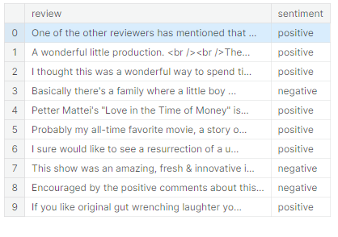
DATA SET Available
IMDB Dataset for Movies review
Amazon Product Data
TWITTER API (USE)

Slide 6
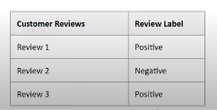
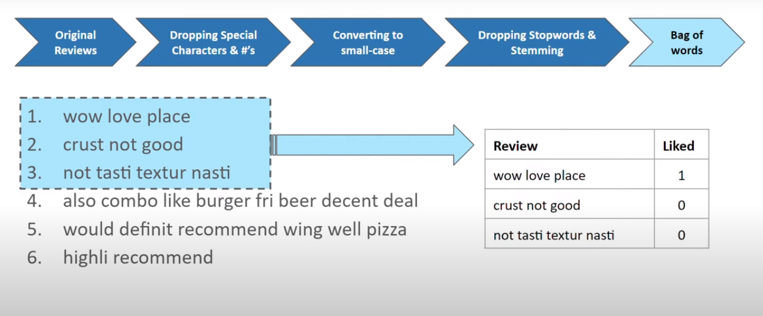

Slide 7
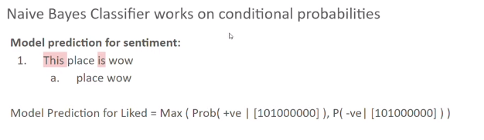
MODEL STUDIED
for optimization of sentiment analysis.
Naive Bayes
One R and other approches
The Naïve Bayes found to be quite fast in learning whereas OneR seems more promising in generating the accuracy of 91.3% in precision, 97% in F-measure and 92.34% in correctly classified instances.

Slide 8
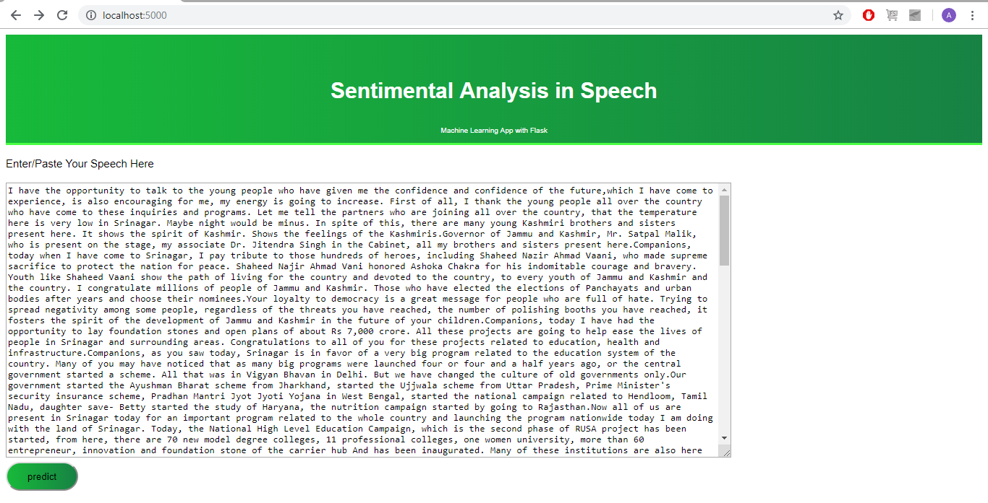
TEST HOME SCREEN FOR NAIVE BAYES :

Slide 9
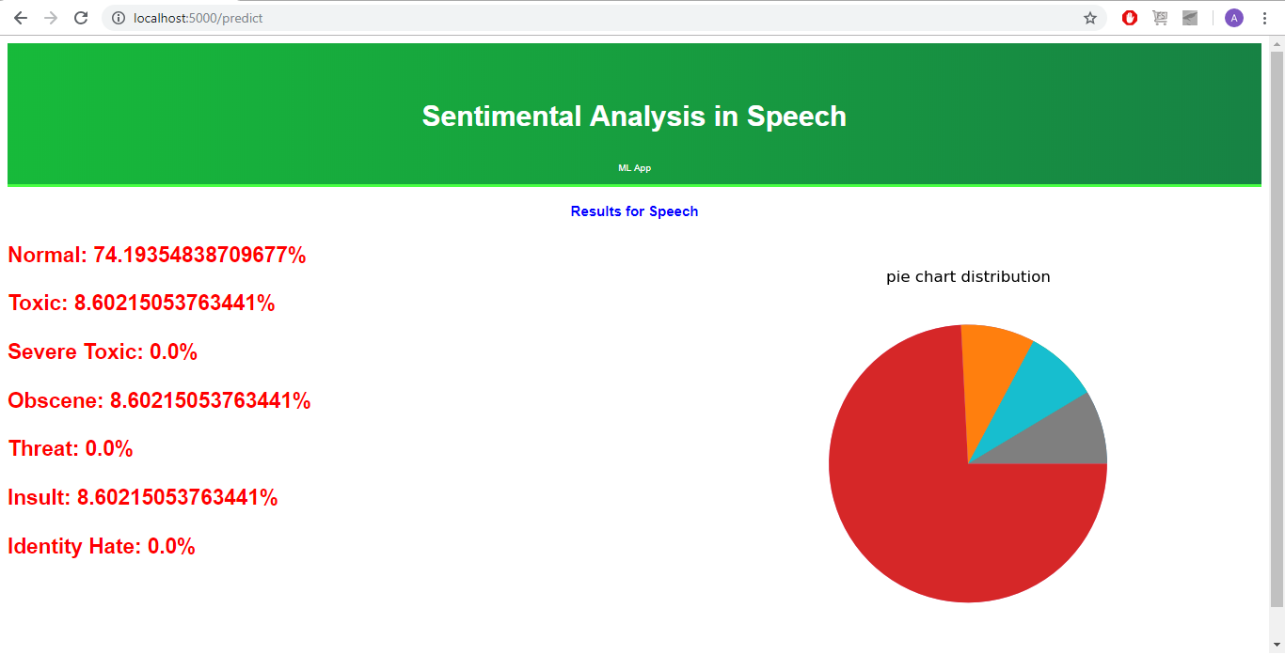
TEST RESULT PAGE (NAIVE BAYES)

Slide 10
MODEL STUDIED : TEXTBLOB
One of the python’s library which uses API for accessing methods in order to perform
Natural language processing is called as TextBlob.
Firstly, the dataset was pre-processed by removing stop words and unrequired data which could result added computational cost in performance of models. It was followed by aspect selection and based on it sentence extraction was done. Both the models were then used to calculate sentiment polarity and categorize the reviews in positive, negative and neutral categories.

Slide 11
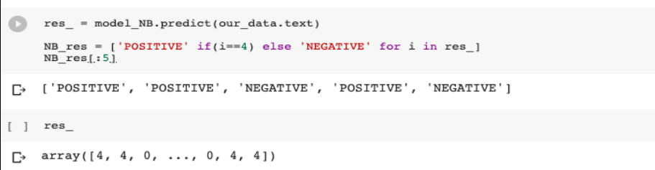
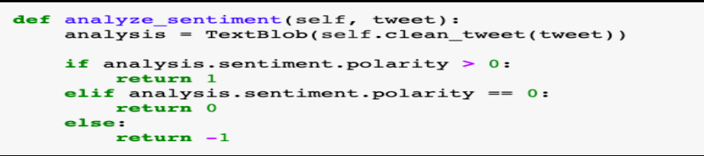
Naive bayes
TextBlob

Slide 12
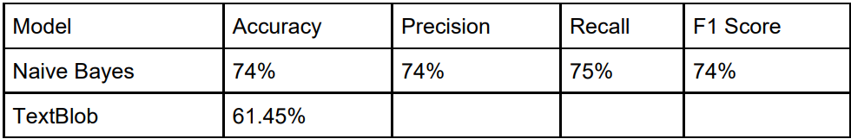
COMPARISON :

Slide 13
OTHER COMPARISON :
High Accuracy and F1 Score: | High Accuracy, Moderate F1 Score: | Consideration for Efficiency
BERT (Bidirectional Encoder Representations from Transformers): | FastText: | Support Vector Machines (SVM):
Accuracy: BERT, with its deep contextualized embeddings, often achieves state-of-the-art results in various NLP tasks, including sentiment analysis. | Accuracy: FastText is known for its efficiency and good accuracy, especially in tasks with large datasets. | Accuracy: SVMs can be effective in sentiment analysis, especially in binary classification tasks.
F1 Score: BERT's ability to capture context and semantics leads to high F1 scores, especially in nuanced sentiment analysis. | F1 Score: While it may not match BERT's F1 scores in nuanced tasks, FastText performs well across various sentiment analysis scenarios. | F1 Score: SVMs can achieve a good balance between precision and recall, resulting in decent F1 scores.

Slide 14
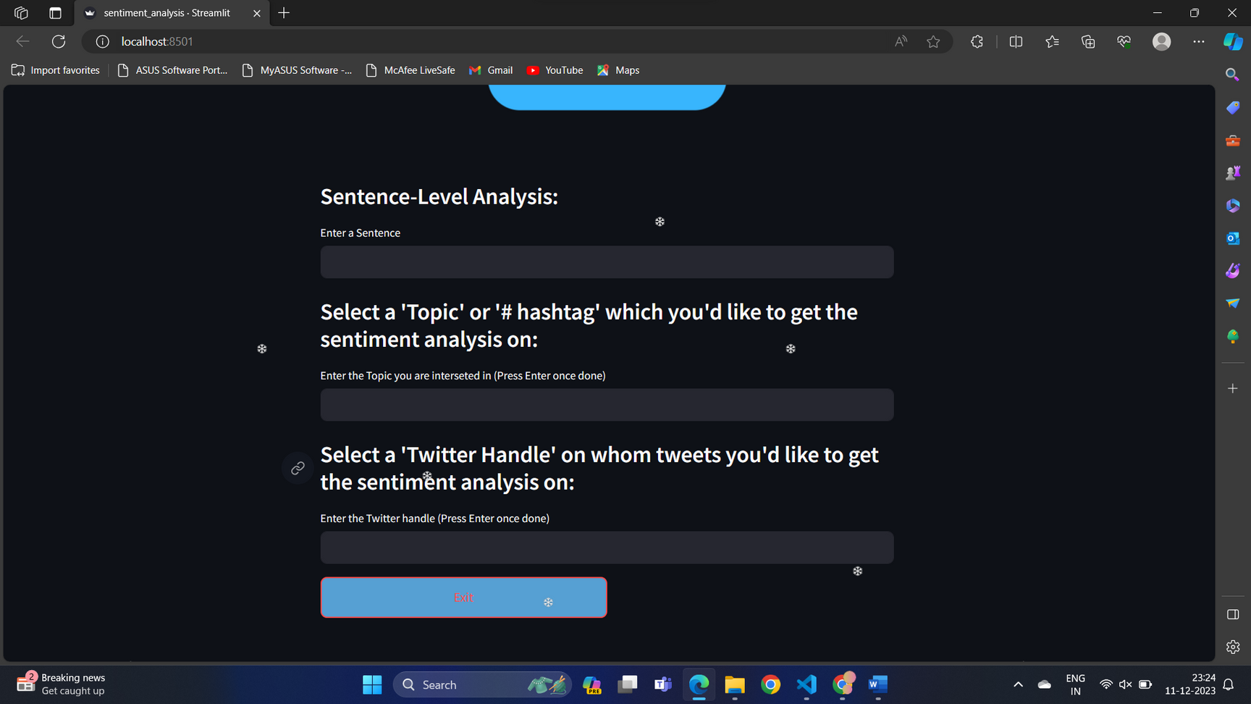
TWITTER SENTIMENT ANALYSIS (TEXTBLOB):

Slide 15
Research Paper BIBLOGRAPHY :
https://textblob.readthedocs.io/en/dev/classifiers.html
https://stackoverflow.com/questions/48860422/text-blob-naive-bayes-classification
https://chat.openai.com/
.https://www.kaggle.com/code/anoopjohny/threads-dataset-analysis/input
Zhang, Y., Jin, R. and Zhou, Z. (2010). Understanding bag-of-words model: a statistical framework. International Journal of Machine Learning and Cybernetics, 1(1-4), pp.43-52.
Park, C. and Seo, D. (2018). Sentiment analysis of Twitter corpus related to artificial intelligence assistants. 2018 5th International Conference on Industrial Engineering and Applications (ICIEA). El Rahman, S., AlOtaibi, F. and AlShehri, W. (2019). Sentiment Analysis of Twitter Data. 2019 International Conference on Computer and Information Sciences (ICCIS).
Goyvaerts, J. (2006). Regular Expressions The Complete Tutorial

Slide 16
THANK YOU

